Slide 1
MODULE II
File Organization:
Indexing Structures for Files and Physical Database Design

Slide 2
Introduction
Indexes used to speed up record retrieval in response to certain search conditions
Index structures provide secondary access paths
Any field can be used to create an index
Multiple indexes can be constructed
Most indexes based on ordered files
Tree data structures organize the index

Slide 3
17.1 Types of Single-Level Ordered Indexes
Ordered index similar to index in a textbook
Indexing field (attribute)
Index stores each value of the index field with list of pointers to all disk blocks that contain records with that field value
Values in index are ordered
Primary index
Specified on the ordering key field of ordered file of records

Slide 4
Types of Single-Level Ordered Indexes (cont’d.)
Clustering index
Used if numerous records can have the same value for the ordering field
Secondary index
Can be specified on any nonordering field
Data file can have several secondary indexes

Slide 5
Primary Indexes
Ordered file with two fields
Primary key, K(i)
Pointer to a disk block, P(i)
One index entry in the index file for each block in the data file
Indexes may be dense or sparse
Dense index has an index entry for every search key value in the data file
Sparse index has entries for only some search values

Slide 6
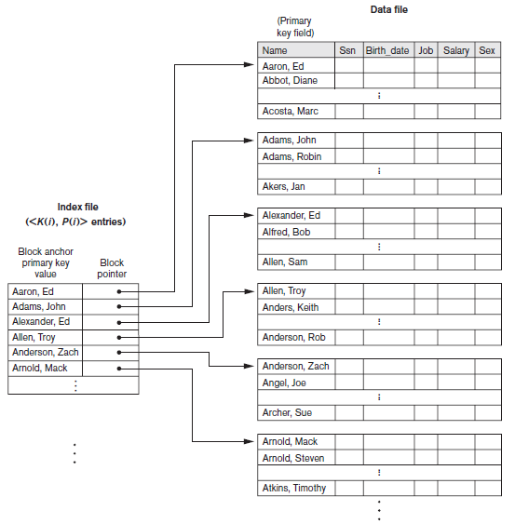
Primary Indexes (cont’d.)
Figure 17.1 Primary index on the ordering key field of the file shown in Figure 16.7

Slide 7
Primary Indexes (cont’d.)
Major problem: insertion and deletion of records
Move records around and change index values
Solutions
Use unordered overflow file
Use linked list of overflow records

Slide 8
Clustering Indexes
Clustering field
File records are physically ordered on a nonkey field without a distinct value for each record
Ordered file with two fields
Same type as clustering field
Disk block pointer

Slide 9
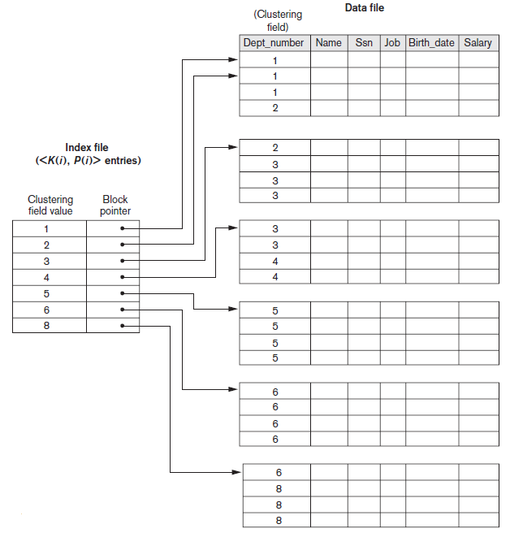
Clustering Indexes (cont’d.)
Figure 17.2 A clustering index on the Dept_number ordering nonkey field of an EMPLOYEE file

Slide 10
Secondary Indexes
Provide secondary means of accessing a data file
Some primary access exists
Ordered file with two fields
Indexing field, K(i)
Block pointer or record pointer, P(i)
Usually need more storage space and longer search time than primary index
Improved search time for arbitrary record

Slide 11
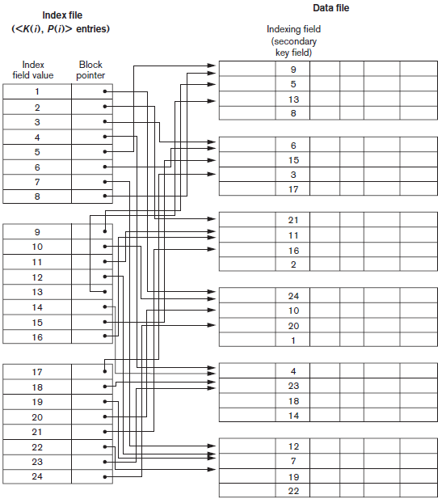
Secondary Indexes (cont’d.)
Figure 17.4 Dense secondary index (with block pointers) on a nonordering key field of a file.

Slide 12
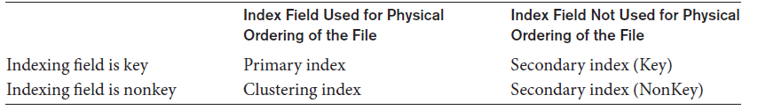
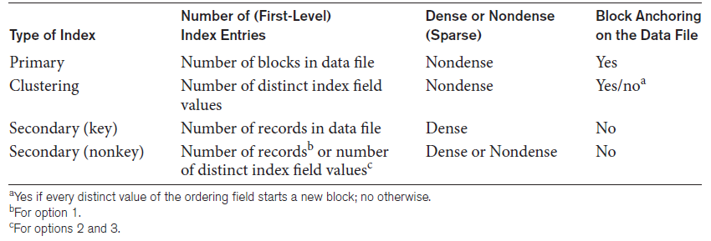
Types of Single-Level Ordered Indexes (cont’d.)
Table 17.1 Types of indexes based on the properties of the indexing field
Table 17.2 Properties of index types

Slide 13
17.2 Multilevel Indexes
Designed to greatly reduce remaining search space as search is conducted
Index file
Considered first (or base level) of a multilevel index
Second level
Primary index to the first level
Third level
Primary index to the second level

Slide 14
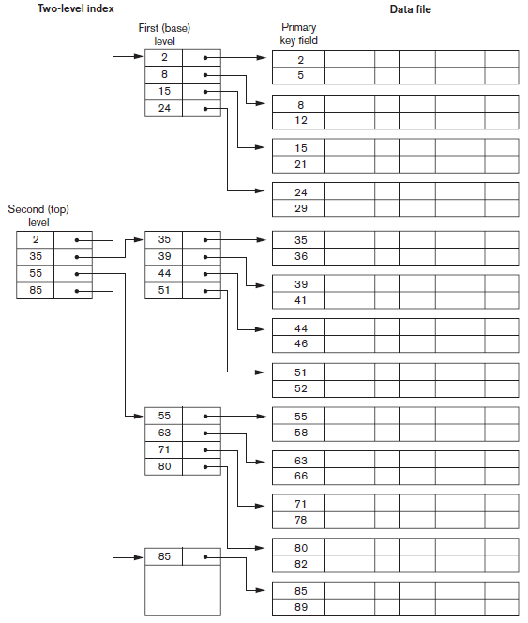
Figure 17.6 A two-level primary index resembling ISAM (indexed sequential access method) organization

